Slide 1
Brazilian E-commerce from Olist
Author: Ahmed Nasser
Date: 2024-03-20

Slide 2
Presentation summary
Introduction
Exploring the data
Find the customer segmentation
Create Churn Analysis
Design a Predictive Model
The recommendations
Appendix

Slide 3
Introduction
As a senior data analyst working at a fast-growing e-commerce platform, Olist, based in Brazil.
The company operates a marketplace connecting sellers and buyers across various product categories.
My task is to analyze the available dataset to derive actionable insights to improve business operations and customer experience, by first answering the business objectives.
In this analysis case study, I'll use the six steps of the data analysis process, which is (Ask, Prepare, Process, Analyze, Share, and Act).

Slide 4
Exploring the data

Slide 5
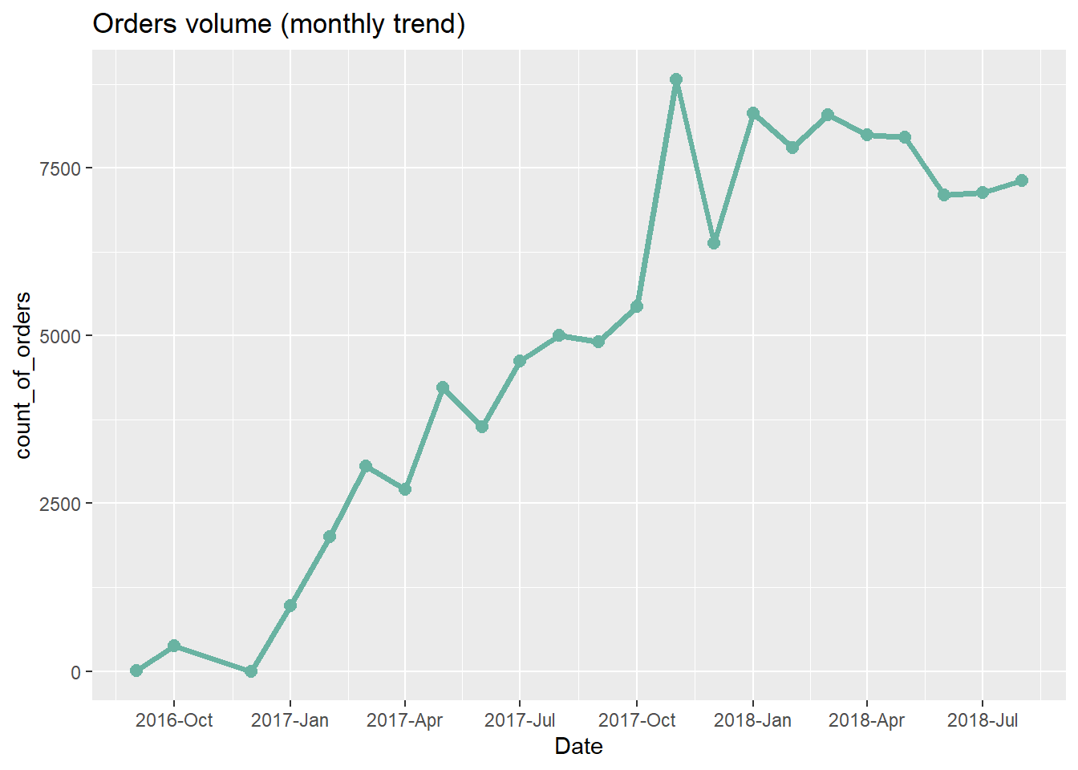
Orders trend
From this visual we notice that the company started at the end of 2016, and with a noticeable increase in the end of 2017
And a near-stability in volume till the med of 2018

Slide 6
customer segmentation

Slide 7
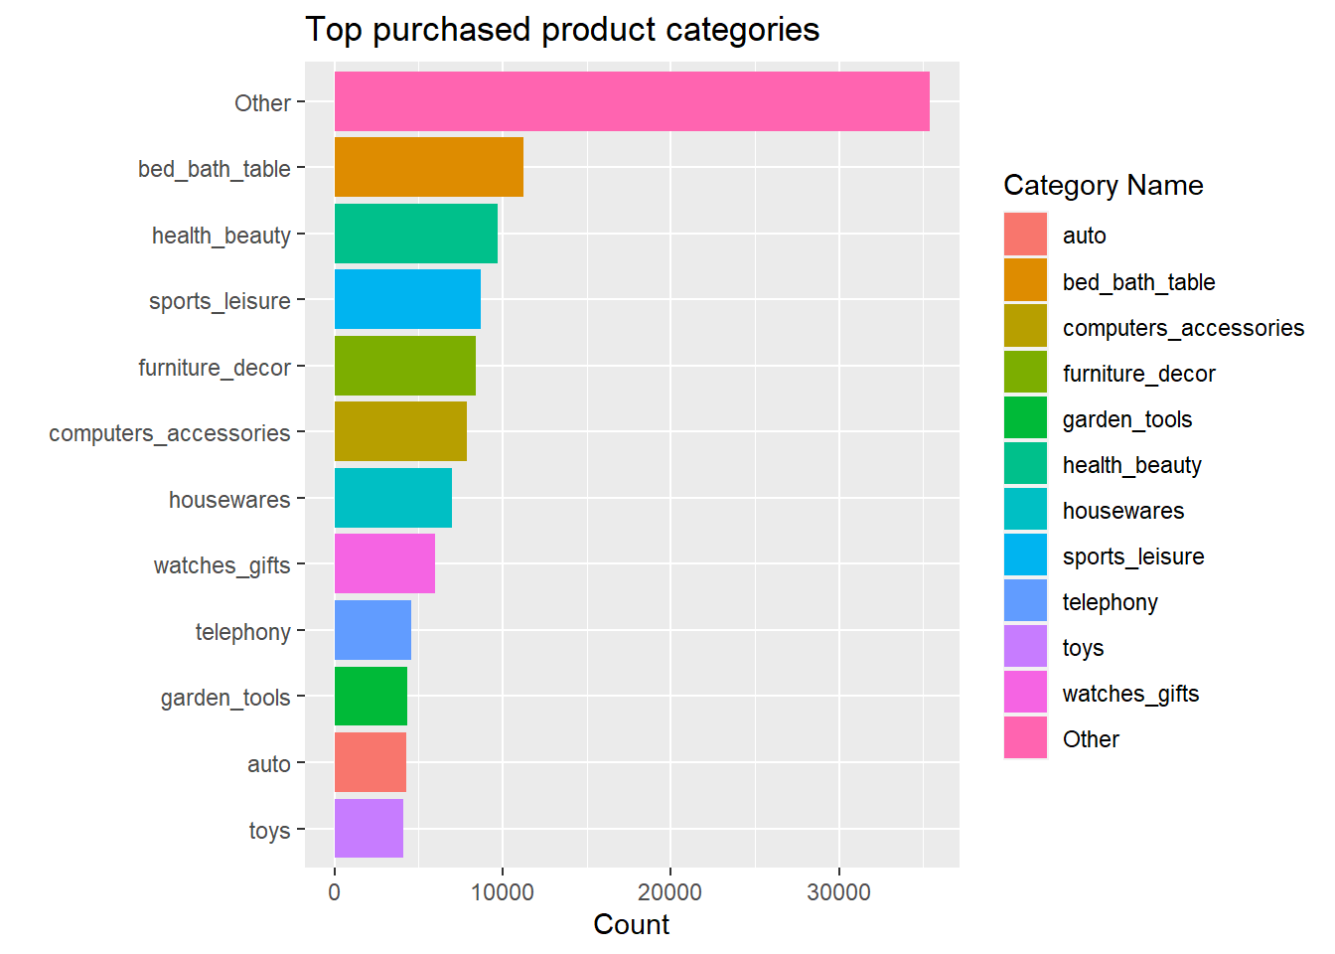
Most purchased products
The best-selling categories are related to home furniture, beauty products, and sports

Slide 8
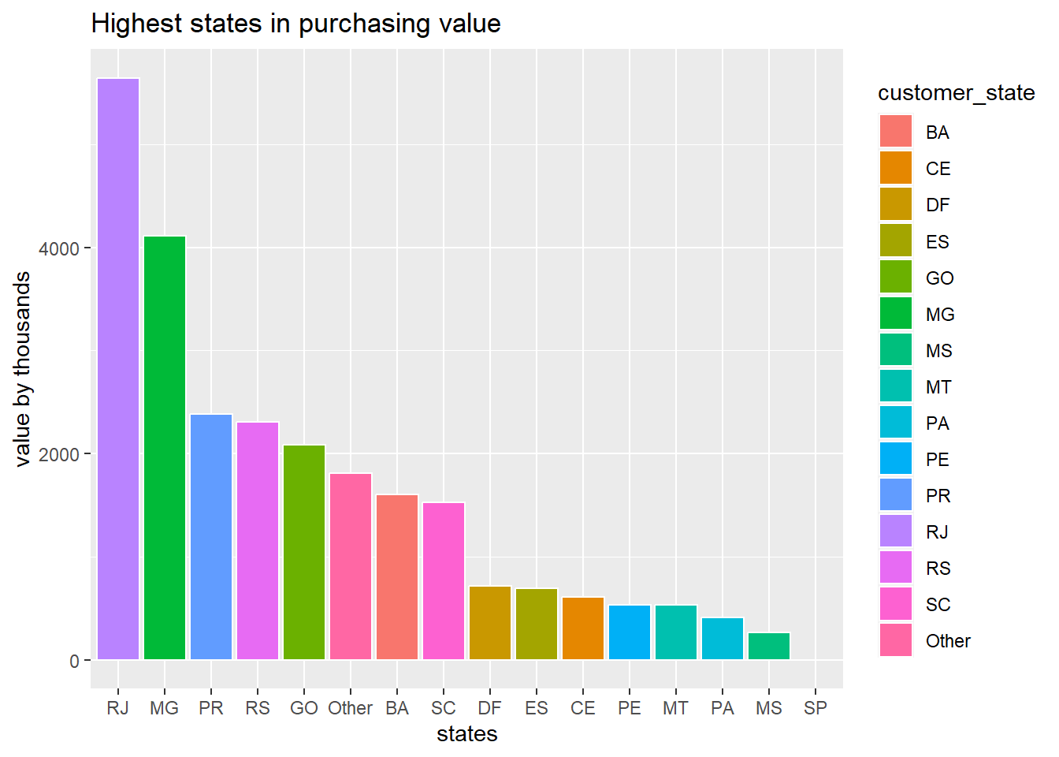
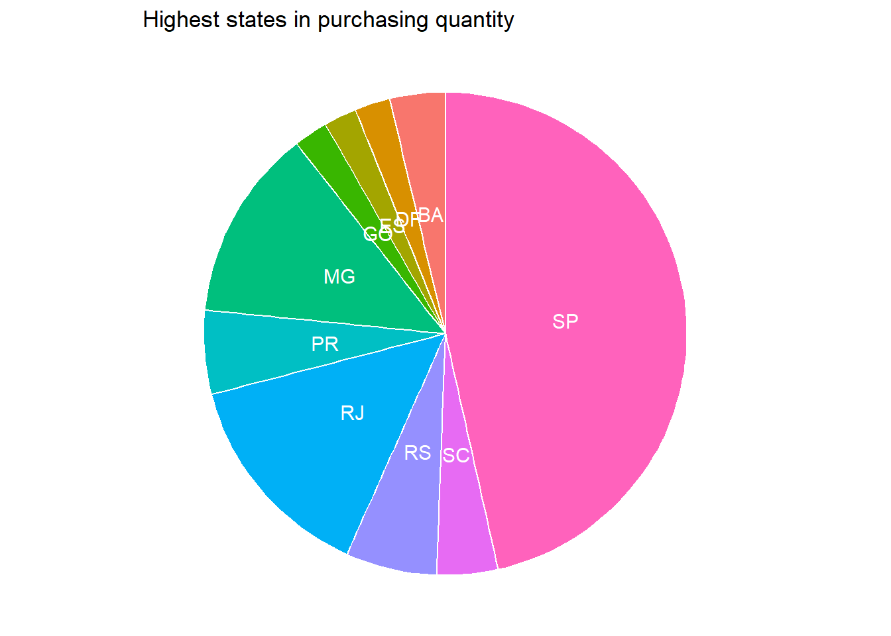
Highest states
The highest states in purchasing value are RJ, MG, and PR
The highest states in purchasing quantities are SP, RJ, and MG

Slide 9
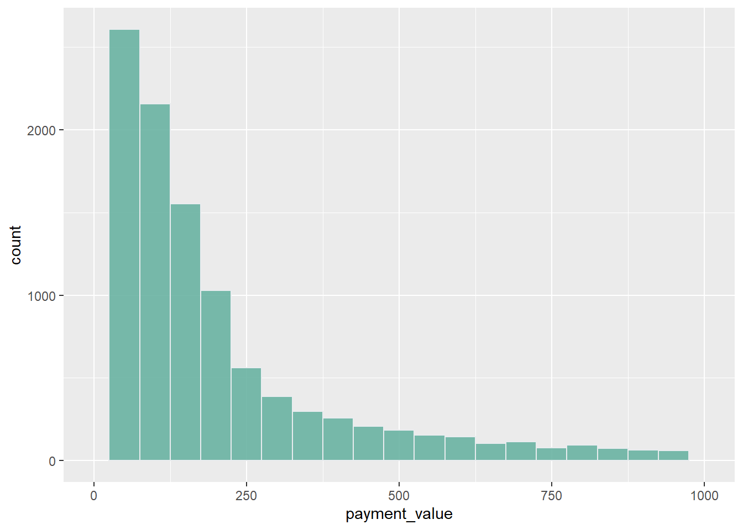
Payments distribution
Regarding the payments value distribution, we found that most selling products are between 50 - 200

Slide 10
Churn Analysis

Slide 11
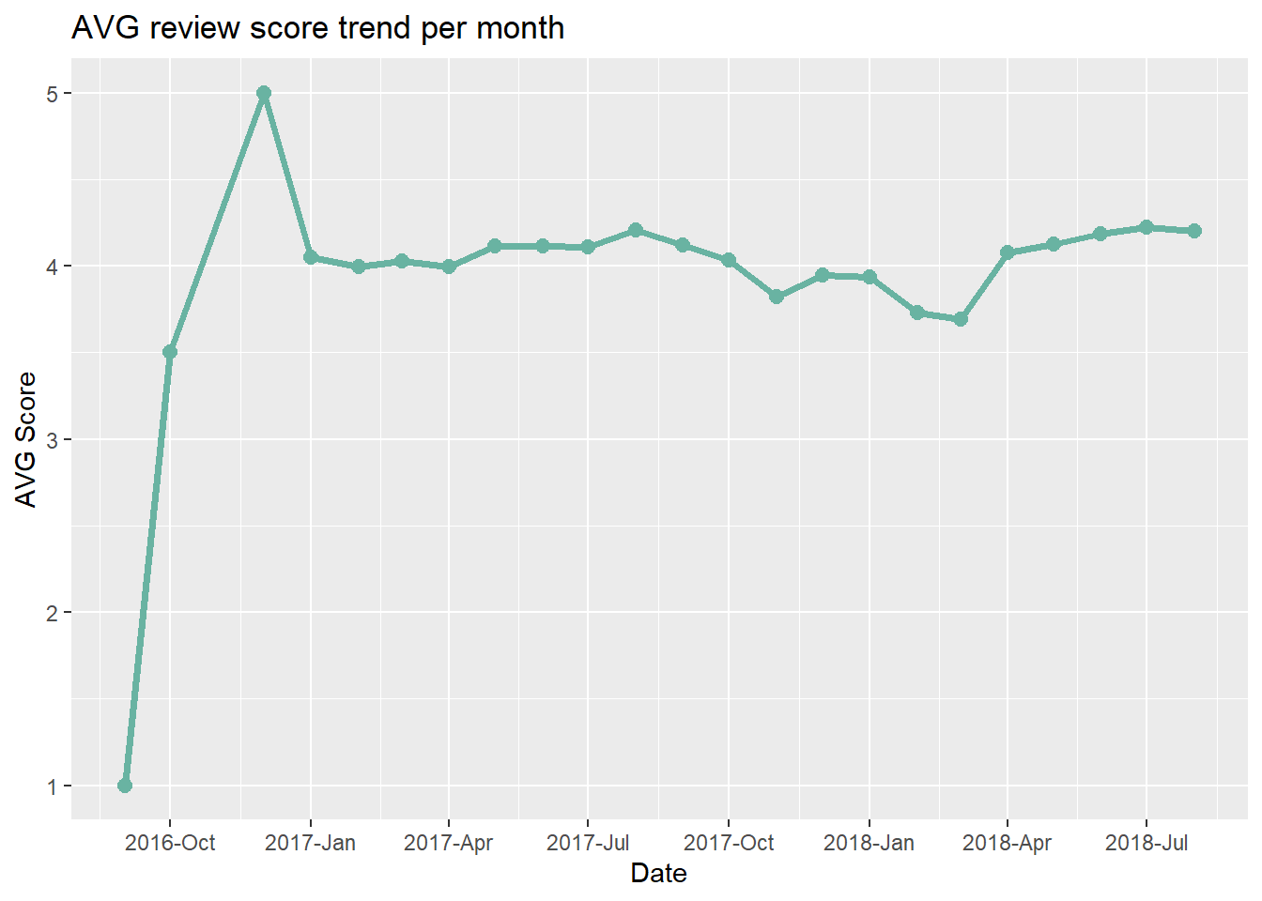
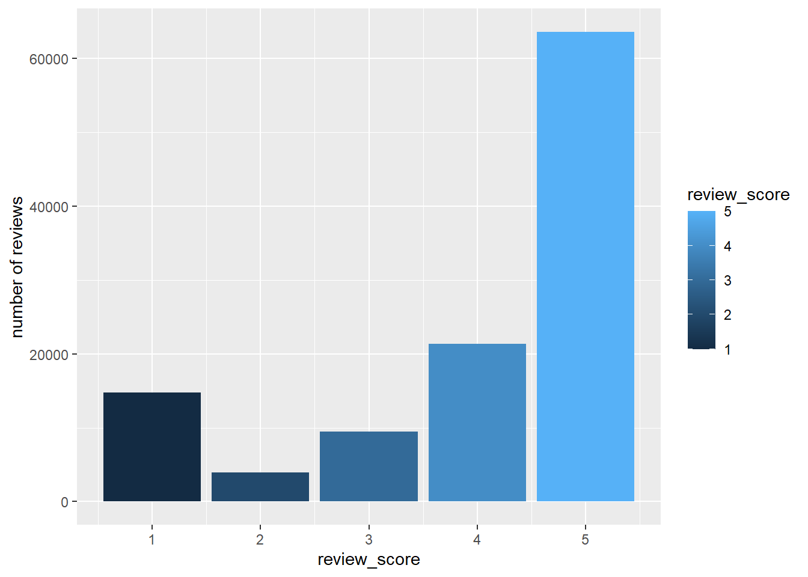
Review score
The review score was at its peak at the beginning, then dropped to around 4
The overall review score is 5

Slide 12
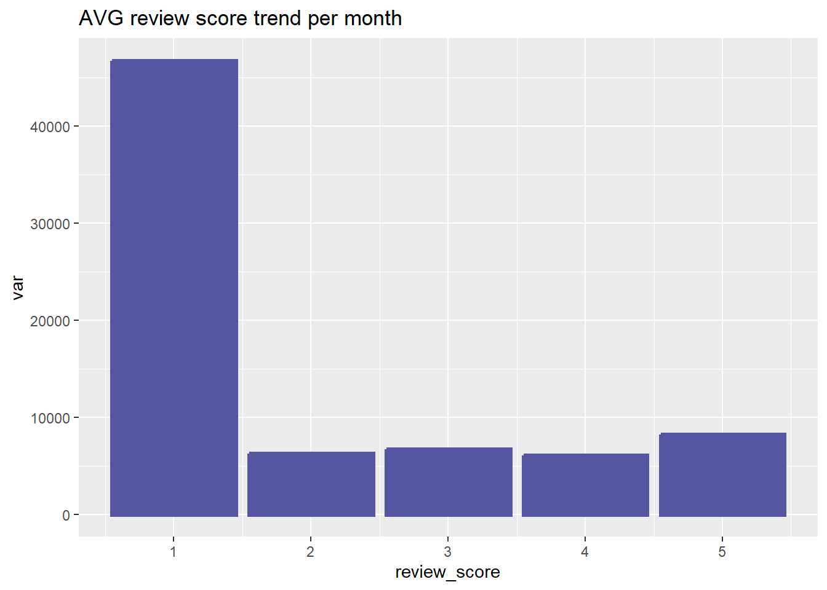
Delay impact
Caused by the delay
The delay in order delivery negatively impact the review score.
And contribute with 30.77% of the overall low score.

Slide 13
Predictive Model

Slide 14
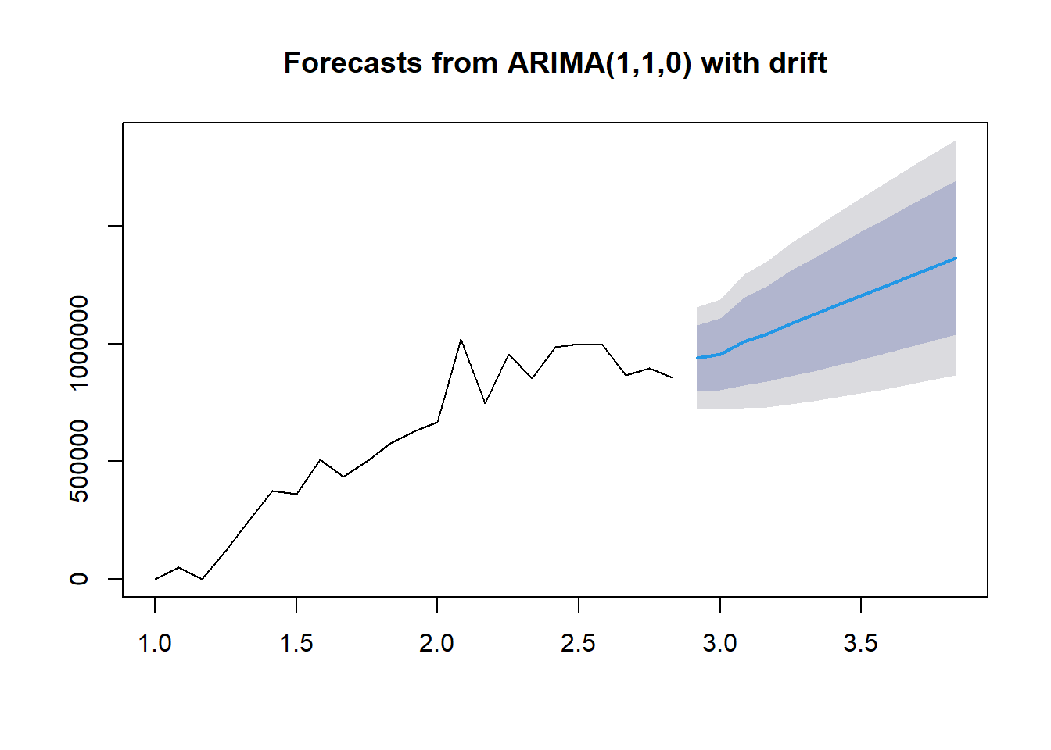
Predictive Modeling
After conducting a churn analysis on the customer segment using the purchasing behavior and geographic location, I created a predictive model to forecast the next 12 months.

Slide 15
The recommendations

Slide 16
Findings & Recommendations
Findings
Recommendations
The company is on a growing scale since the beginning.
The price & quantity sales seasonality peak is in the fourth quarter of the year.
Most selling categories are related to home furniture, beauty products, and sports.
The highest states in purchasing value are RJ, MG, and PR.
The payments value distribution are between 50 – 200.
The company’s rating are normally, but the order delivery delay have a high impact on the low ratings.
Develop a main dashboard with the most selling categories in the company user’s app.
Prioritize the low-price items in the search feature in the user’s app, to enhance the customer experience.
Minimize the order delivery duration, to enhance the customer’s reviews score or increase the estimated delivery time to develop honesty with the customers.
Cooperation with the SEO team to increase the advertising in the highest states and cities in purchasing, to increase the customer base.

Slide 17
Appendix
Link for the documentation files on GitHub:
github.com/a7mdNasrr/Olist-Brazilian-E-commerce-Analysis-Project

Slide 18
THANK YOU
Ahmed Nasser, Data Analyst
Email: a-n-ahmed@hotmail.com
Portfolio: a7mdnasrr.github.io/AhmedNasser.github.io

